Slide 1
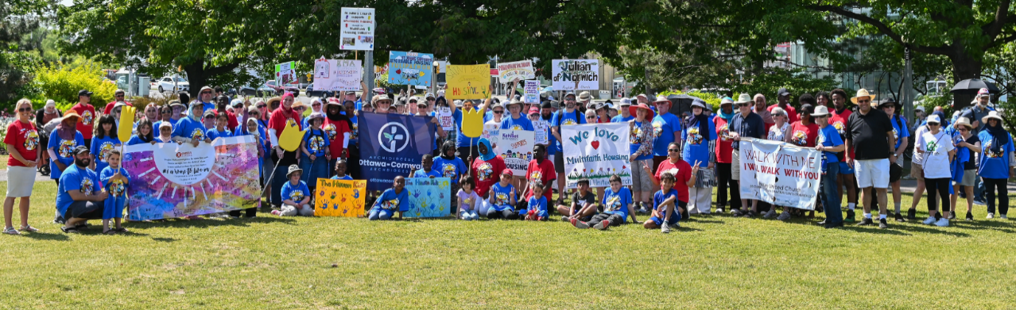

MHI's mission is to provide and promote safe, affordable, and well-maintained housing in inclusive communities, and to mobilize resources for these purposes.

Slide 2
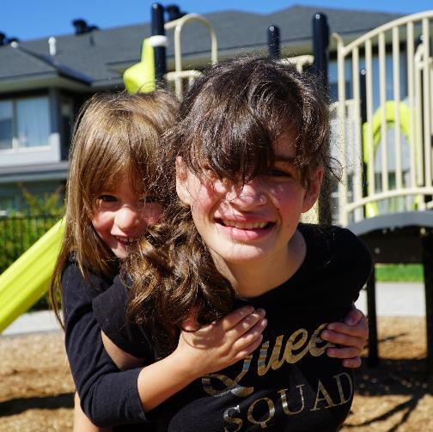
How many people live in MHI communities
422 rental units (1-4 bedroom units)
9 communities (Barrhaven, Centretown, Vanier, Gloucester, Blackburn Hamlet, Orleans)
1,500+ residents

Slide 3
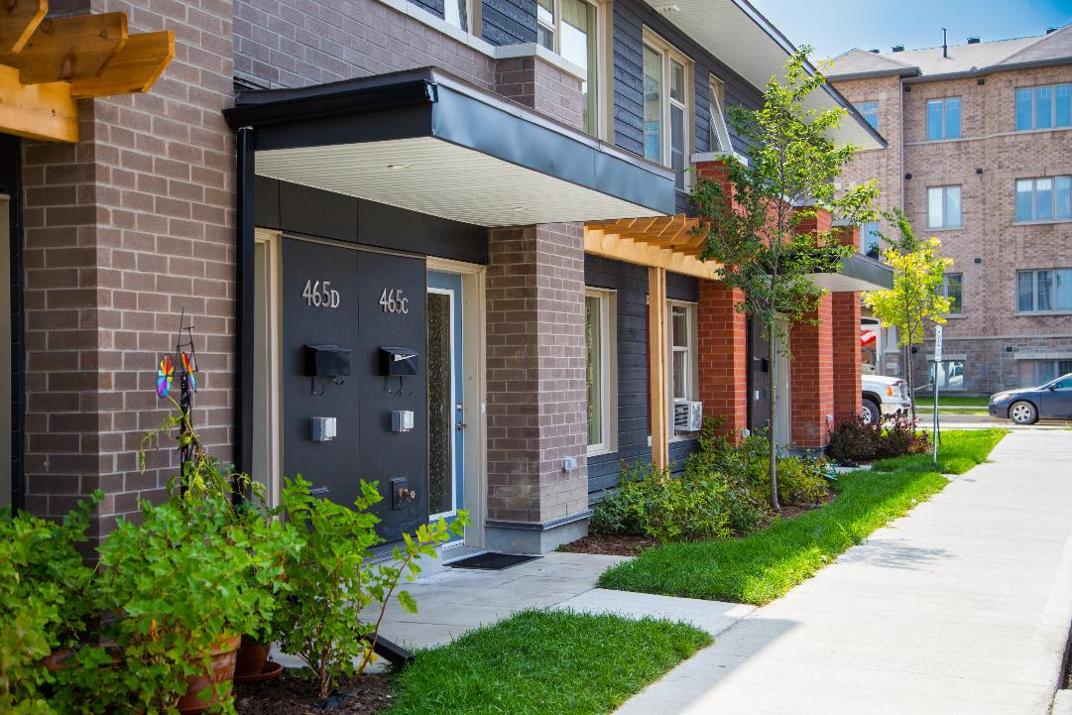
The Haven – completed 2017

Slide 4
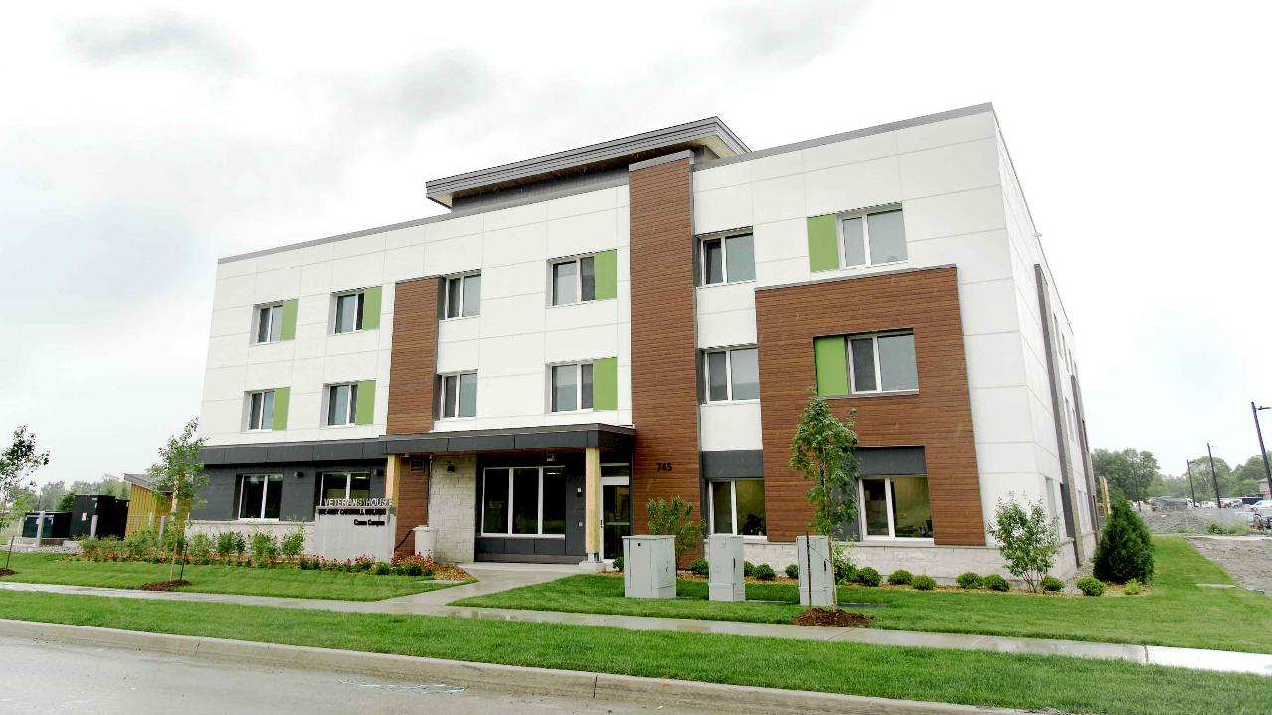
Veterans’ House Canada – completed 2021

Slide 5


Slide 6
United We Dream
Fundraising Campaign
Fundraising Goal: $150,000
Raised to-date: $128,425 (85.6%)
Started in Fall 2024
19 United churches have made a donation or held a fundraiser to raise funds for the campaign

Slide 7
United We Dream
Fundraising Campaign
The United Churches of Canada Foundation
  2 grants totaling $60,000 (Seeds of Hope Granting Program)
8 concerts organized to-date ($28,500) with 2 upcoming concerts
  Saturday, May 30 – Rideau Park United (Big Soul Project)
  Friday, June 5 – Barrhaven United (Retrosonics)

Slide 8
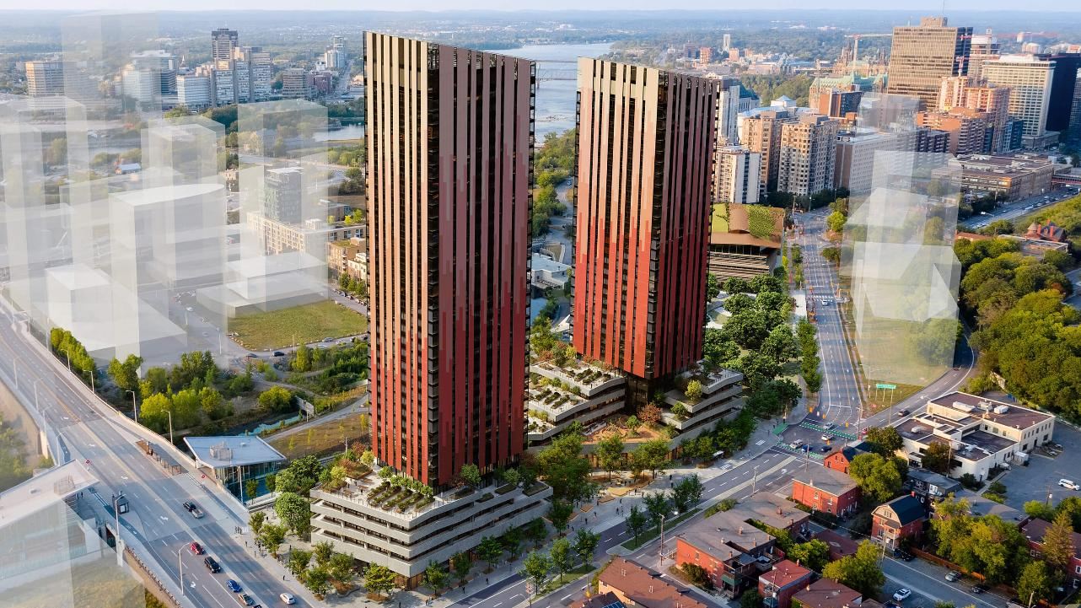
Odenak – Lebreton Flats

Slide 9
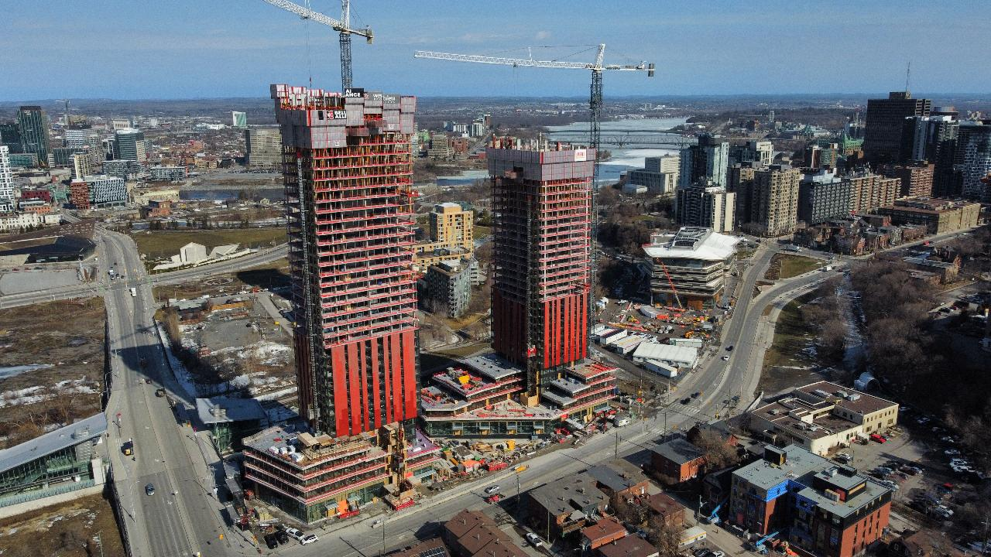
Odenak – Lebreton Flats
Completion date Dec. 2027

Slide 10
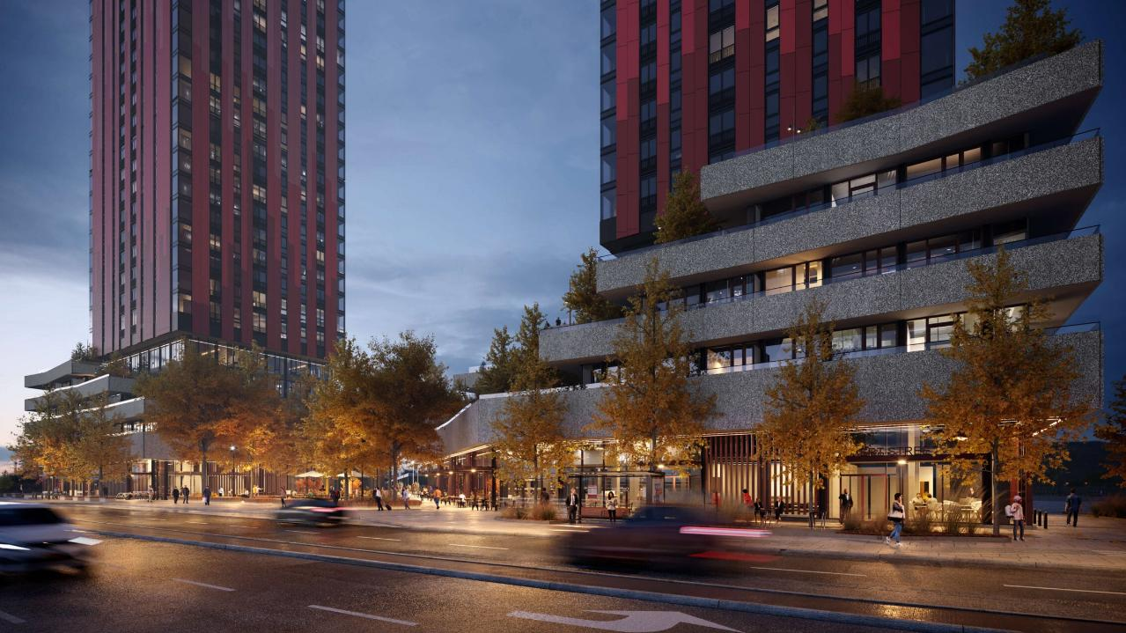
Odenak – Lebreton Flats

Slide 11
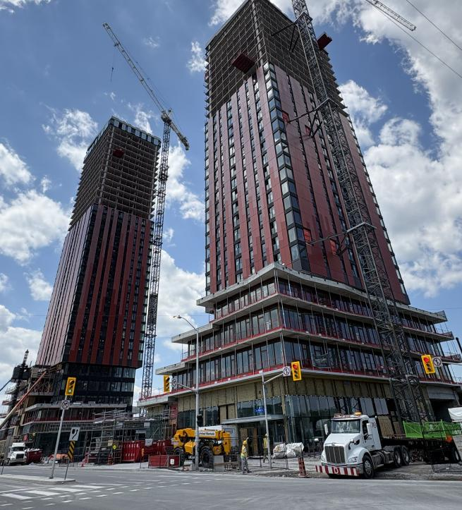
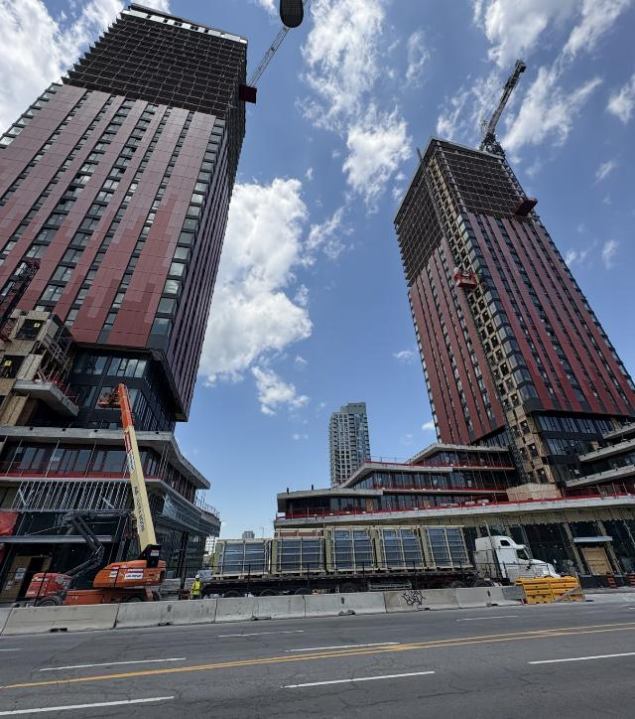
Odenak – Lebreton Flats

Slide 12
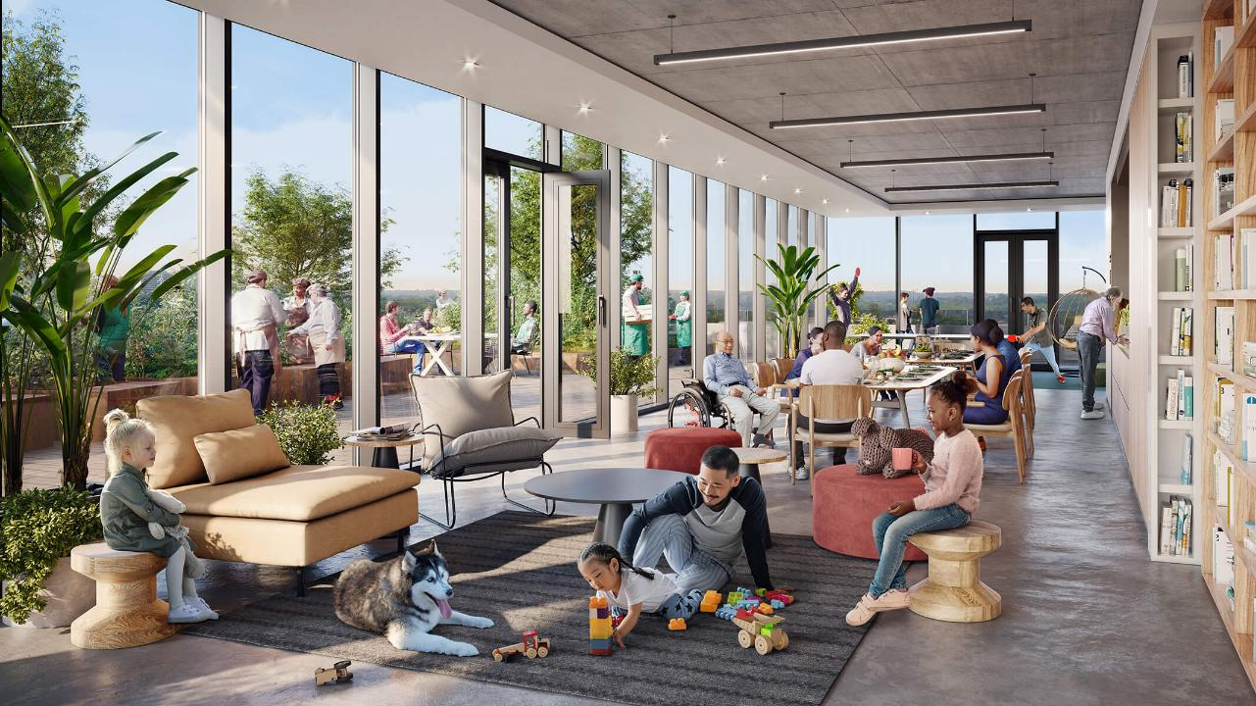
Odenak – Lebreton Flats
Community Hub

Slide 13
Odenak – Lebreton Flats
Community Garden

Slide 14
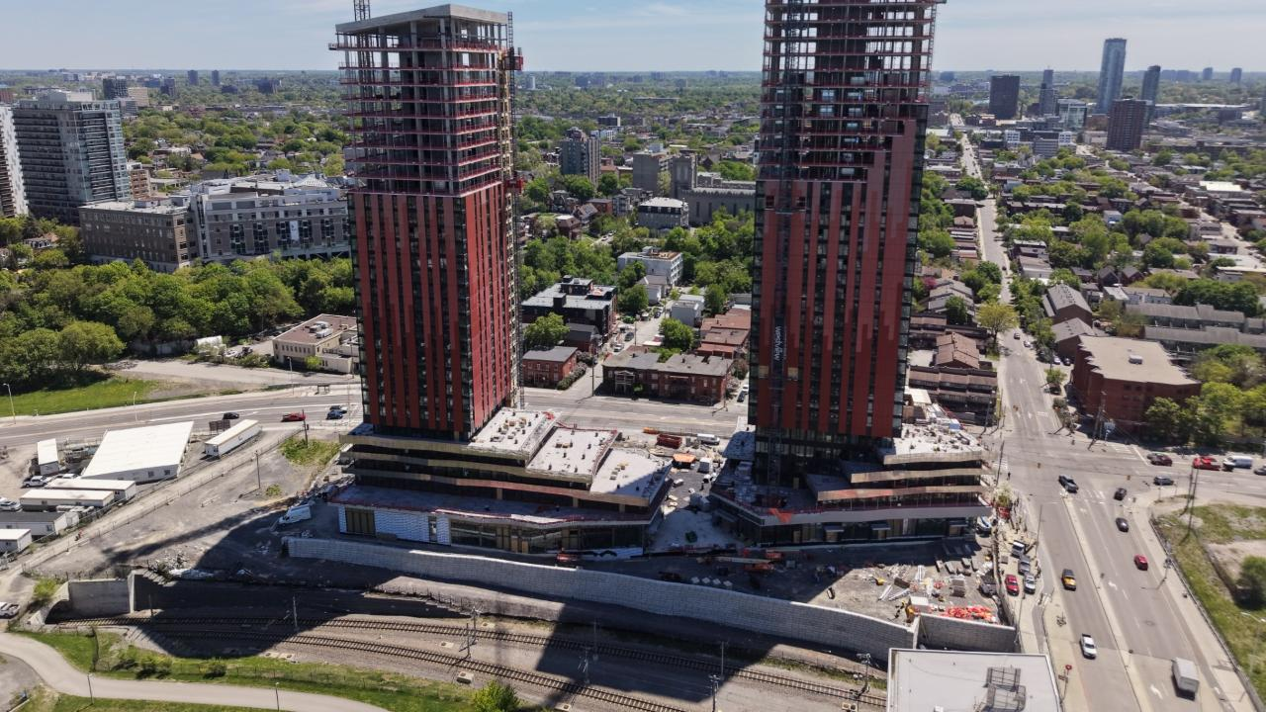
Odenak – Lebreton Flats

Slide 15
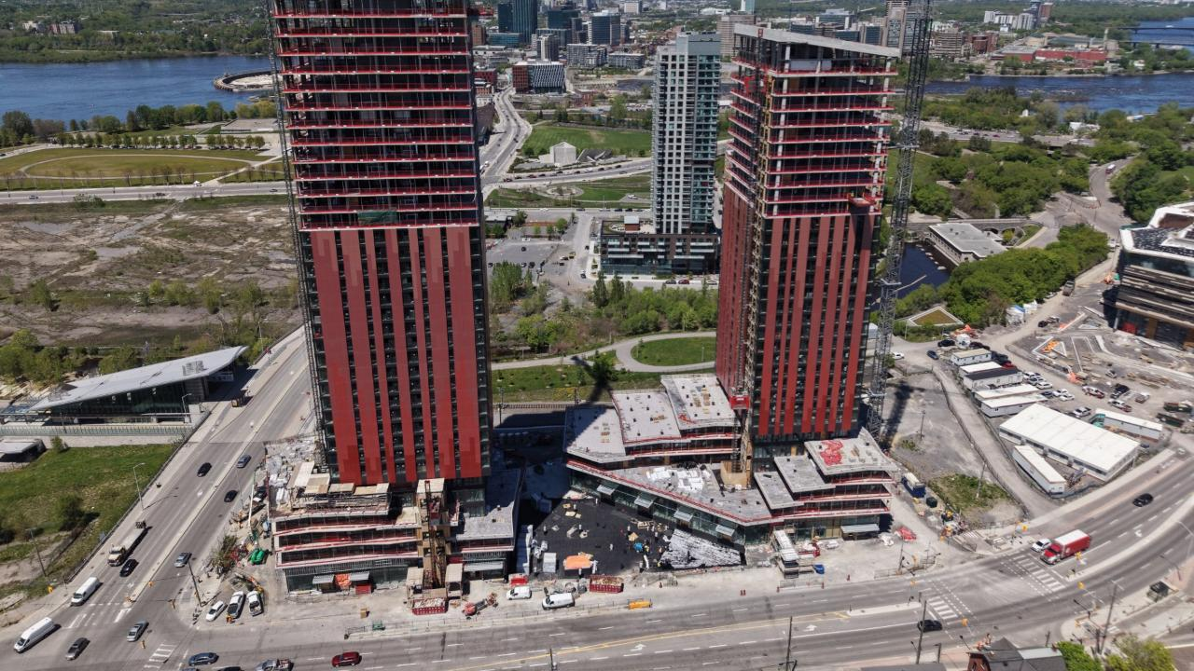
Odenak – Lebreton Flats

Slide 16
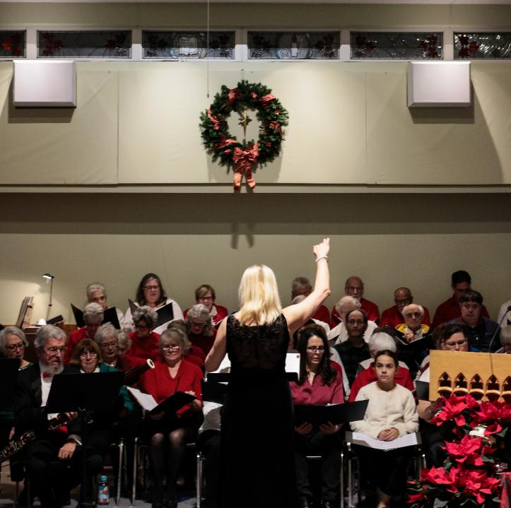
Thank you for your support!
  Friday, May 30
  Rideau Park United
  (Big Soul Project)
  Saturday, June 5 Barrhaven United (Retrosonics)

