Slide 1




Slide 2



CBS' vision is to help people hear God speak through His written Word, the Bible, so that they would encounter and know the Living Word, Jesus Christ

Slide 3


Where people are at risk,
when faith is under siege,
to millions craving hope and
a generation seeking purpose,
God speaks, we help them hear.

Slide 4


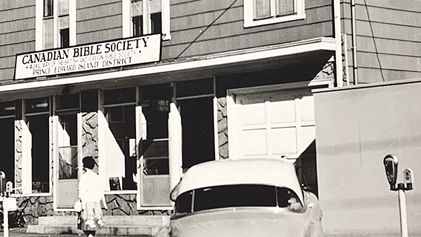
Since 1906
Answering the seeking heart...
English immigrants, Gaelic-speaking highlanders, Moravian missionaries, travelling salesmen, relentless volunteers and outward-looking churches fuelled the establishment of what became the Canadian Bible Society.
Notes:
The first Bible Society district was formed in Canada in1809. Following an Act of Parliament and Royal Assent, in 1906, CBS was established.

Slide 5

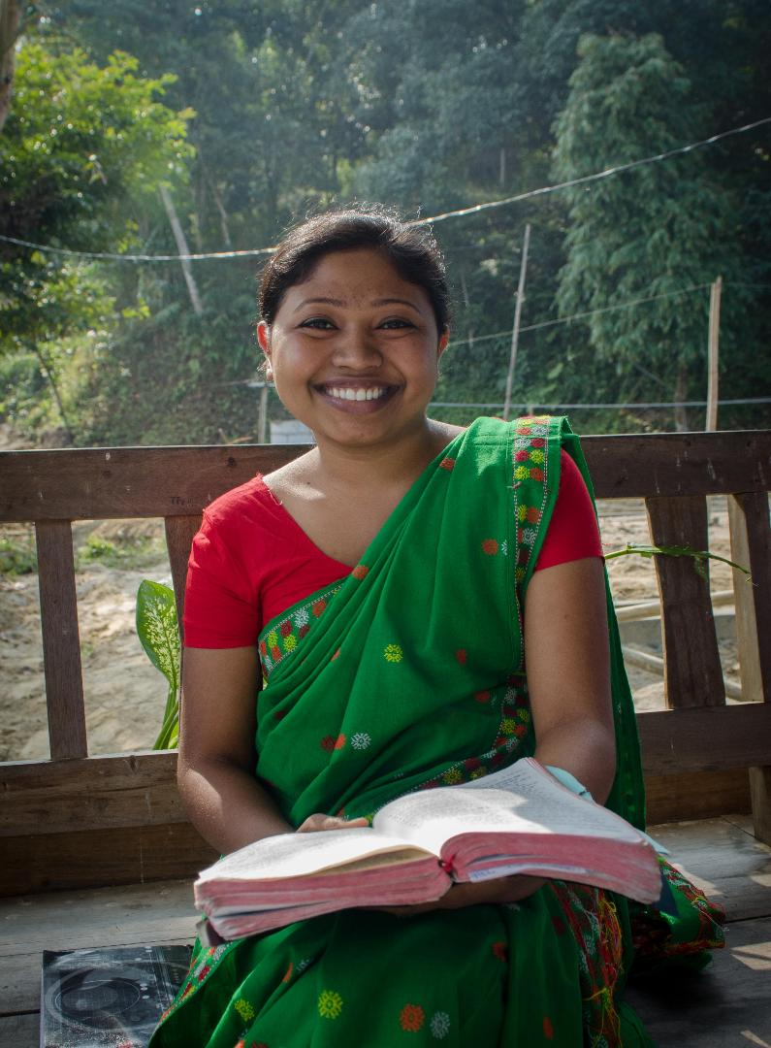
United Bible Societies
A fellowship of 150 Bible Societies with a footprint in 240 countries and territories.
Globally, UBS is the largest Bible agency.
UBS is responsible for over 70% of all full Bible translations that exist around the globe.
Notes:
CBS is part of the United Bible Societies (UBS), a fellowship of around 150 Bible Societies with a footprint in 240 countries and territories.
Globally, UBS is the largest Bible agency. UBS is responsible for over 70% of all full Bible translations that exist around the globe.
To date, UBS has translated the entire Bible into the languages of around half the world’s population.
Vision: Complete 1200 Bible translations by 2038 and make the Word of God accessible to 600 million people.

Slide 6
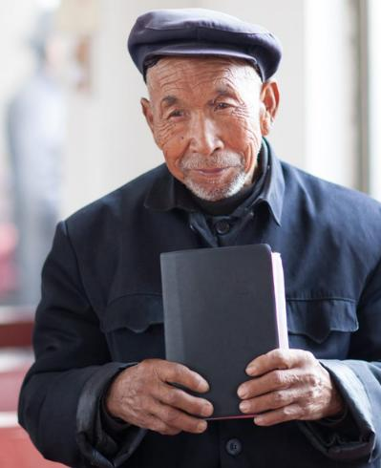
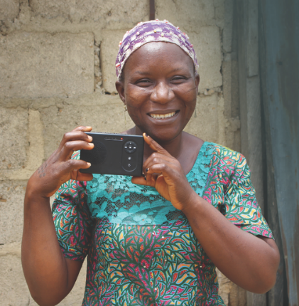
We are
all about the
The Bible, in the hands of a person. When and where it’s most needed.
In the language closest to that person’s heart.
Bible
In a format easy for them to use, with help to understand it for themselves.
We champion the Bible as
the voice of God, revealing
Jesus Christ, the Living Word.

Slide 7

Barriers Prevent People from Hearing God Speak
Bible Poverty:
Lack of access
Bible Literacy:
Difficulty understanding
Bible Relevance:
Difficulty in applying to life

Slide 8

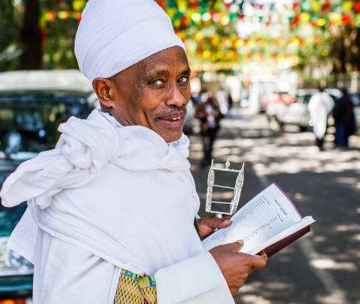

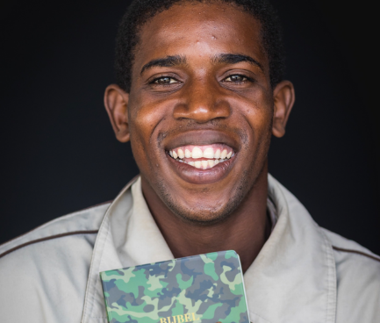





We Translate
We Publish
We Distribute
We Engage
We make sure God's Word is available in the languages that speak to the hearts of people.
We produce God's Word in formats people can use.
We get God's Word into the hands of waiting people.
We help people find their way to the message God has for them.
Notes:
CBS operates across the full Bible lifecycle: we translate, publish, and distribute the Bible, and help people engage with it.
We are interconfessional: we serve and work with churches of all traditions and denominations—Catholic, Orthodox, Protestant and emerging.

Slide 9



2024 Highlights
631,298
Bibles, Testaments and Scripture selections distributed in Canada.
Scriptures made available in 71 languages
other than French and English in Canada.
56 projects for Bible ministry and translation in 36 countries outside of Canada, through UBS.

Slide 10
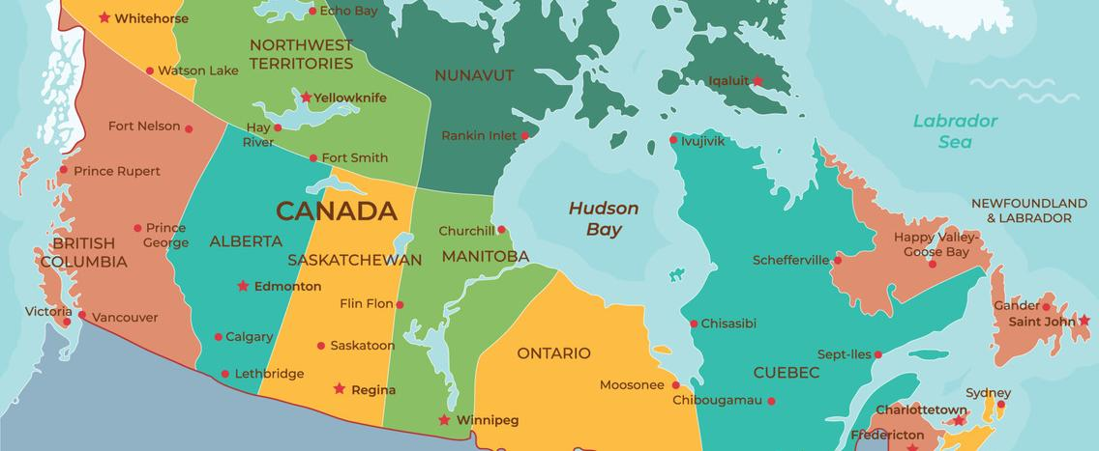
Our Work – In Canada

Slide 11
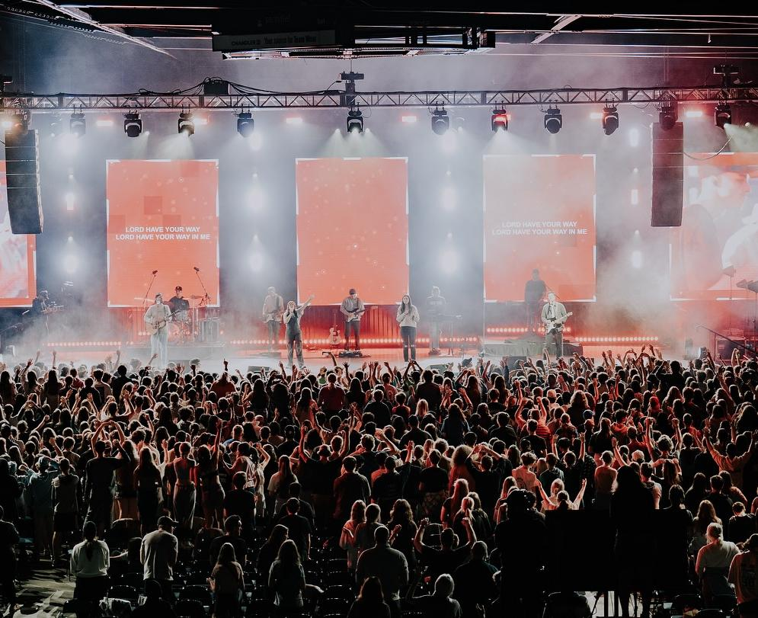
In Canada
Bible-Based Trauma Healing
Overcomers
Diaspora Church Engagement
Scriptures for the Elderly
Youth At Risk

Slide 12

In Canada
Two Bible-based recovery programs: Trauma Healing and Overcomers.
We partner with the diaspora church and provide them Scriptures in their heart languages.
In Canada, CBS makes Scriptures available in 70+ languages.
We distribute more than half a million Bibles, Testaments and Scripture selections per year in Canada.
Audio Scriptures for the elderly in 50+ languages.
In the past decade, CBS helped provide Scriptures (including portions) in 12 Indigenous languages.
In 2023 we published the complete Bible in Mohawk.
With 100 episodes and 100,000 downloads and counting, our Scripture Untangled podcast helps Canadian Christians unpack Scripture.
Notes:
This slide is about Canadian programs, just in detail.
Top 10 languages (other than French or English) Haitian Creole Chinese Spanish Arabic Mohawk Persian Plautdietsch Punjabi Ukrainian Tagolog.
Of the 67 Indigenous languages spoken in Canada today, only four have their own Bibles.
37 Indigenous languages in Canada have some translated Scripture.

Slide 13
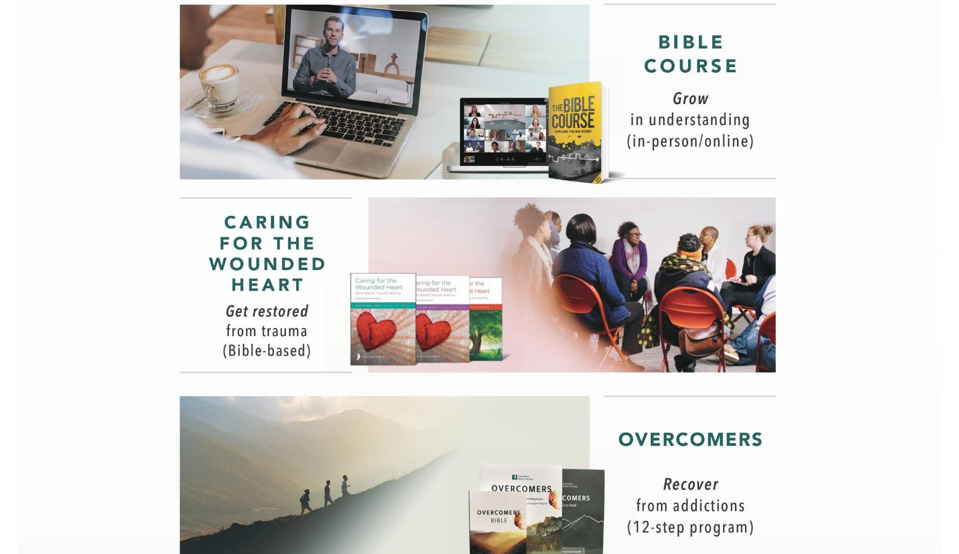

Slide 14
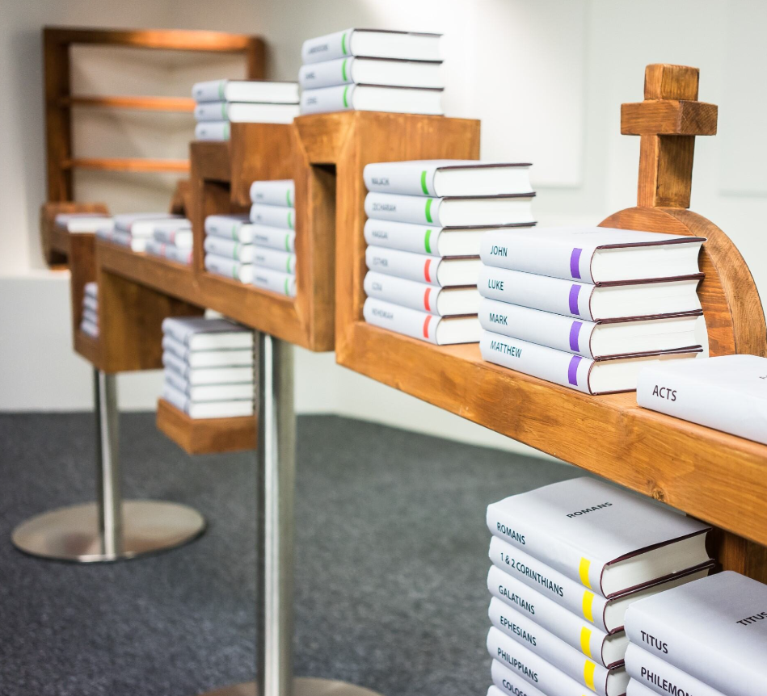



The Bible Course
Unique storyline
A great overview of the Bible
Videos, guides, diagrams and readings
Eight-session course
For in-person or online groups
Notes:
Use points from The Bible Course - Canadian Bible Society

Slide 15
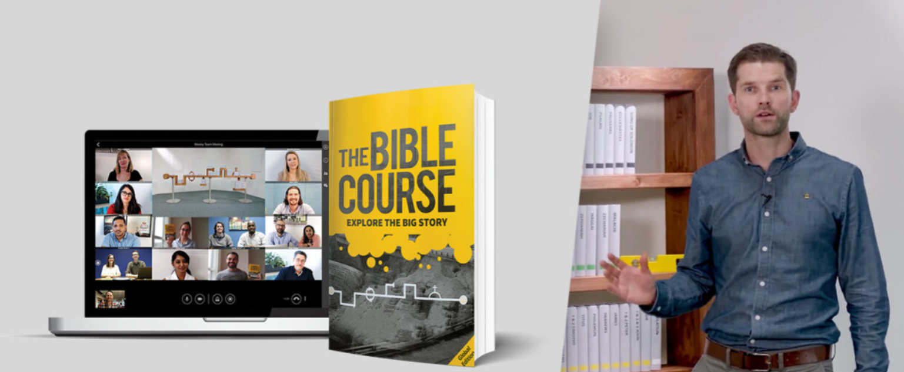
“Our family, through the eight sessions, discovered a captivating overview of the Bible story. All of us found this edifying course provided an invaluable framework of God’s actions and plans, which has spring boarded into a deeper study and understanding of God and His Word. We are confident others will have the same fulfilling experience.” — A family from Redwood Park Church, Thunder Bay

Slide 16


BIBLE-BASED TRAUMA HEALING
GAINS MOMENTUM
Trauma Healing ministry draws on the restorative power of God’s Word.
“The best thing I learned is forgiving and taking the burden to the Cross. I feel released, happy, open, light, and delighted that I forgave all the people that hurt me a lot and I am now free enough to grow spiritually and personally.”
—A refugee
Notes:
CANADA: Caring for the Wounded Heart - Canadian Bible Society

Slide 17


LOUD AND CLEAR IN
LONG-TERM CARE HOMES
“After I became completely
blind, not being able to read the Word of
God was a huge setback. With the audio
device, it has been SO VERY ENCOURAGING to
hear the Word of God—it touches my soul. We
leave the music on so my wife and I could enjoy
it together. Thank you, CBS, for opening this
inroad into my soul! I pray that you continue to
expand this ministry to many others like myself. It
has made a big difference in my life!”
By the end of 2024, CBS reached 10,000 residents of long-term care homes via audio Bibles.
— Bruce Littlejohn, Ex-Missionary
Notes:
Interviewed 200 long-term care homes to understand needs.
Delivered 1020 Audio Bible units to the elderly or their caregivers.
Distributed units in English, French, Ukrainian, Hindi, and Chinese.
By the end of 2021, CBS reached 4,000 residents of long-term care homes via audio Bibles.

Slide 18
CBS' vision is to help people hear God speak through His written Word, the Bible, so that they would encounter and know the Living Word, Jesus Christ

Slide 19
Where people are at risk,
when faith is under siege,
to millions craving hope and
a generation seeking purpose,
God speaks, we help them hear.

Slide 20

biblesociety.ca | info@biblesociety.ca

