Slide 1
2026
General Council
Office Report

Slide 2

Greetings
“And let us consider how to provoke one another to love and good deeds, not neglecting to meet together, as is the habit of some, but encouraging one another…”
--Hebrews 10:24-25
Notes:
Your own intro if it wasn’t done…..
Delighted to be with you. We are one body across this beloved church.
The instructions to the early church were to “not neglect to meet together” –as you are doing.
And in their spirit, I bring encouragement. Across this church whether communities of faith, regions or the general council. Let us “provoke one another to love and good deeds.”
Today I will touch on:
2025 Strategic Plan
Toward 2035
General Secretary Search
Structure Review
But I am also around to answer questions. And if I don’t know, I can be sure to arrange to get back to you.

Slide 3






The General Council Office’s Strategic Plan is helping the church realize our Vision, working closely with regional councils across the country.
The first six months of 2026 have focused on concluding some initiatives and moving to 2026-2028 Strategic Plan—a shift from measuring activity to impact.
Embolden Justice
Collaborating to Mend
Church and World
Deepen Climate Integrity
Living Climate Commitments
Invigorate Leadership
Adapting and Innovating
for Bold Discipleship
Strengthen Invitation
(Growth)
Humility and Confidence
in Sharing Faith
Nurture the Common Good
Equity and Sustainability
in Resources
Journeying Indigenous Pathways
Forging Right Relations
Notes:
Beginning with the General Councils 2025 Strategic Plan Report
We have been working over the last three years (2023-2025) under six objectives. This year was the
plan’s final year.
Many of the gains we made over these last years are helping us frame and develop Toward 2035.

Slide 4
Learn more about the Strategic Plan by searching “Our Call and Vision”
on united-church.ca and selecting the link for each strategic objective.
See the full 2025 Strategic Plan Report by following
this QR code or visit united-church.ca/call-vision
Notes:
You can find the full 2025 report through the following QR code.
• More information about our Strategic Plan, including the full text of each objective and detailed
progress updates, are on the Our Call and Vision section of united-church.ca. This report is also
available in French on egliseunie.ca

Slide 5
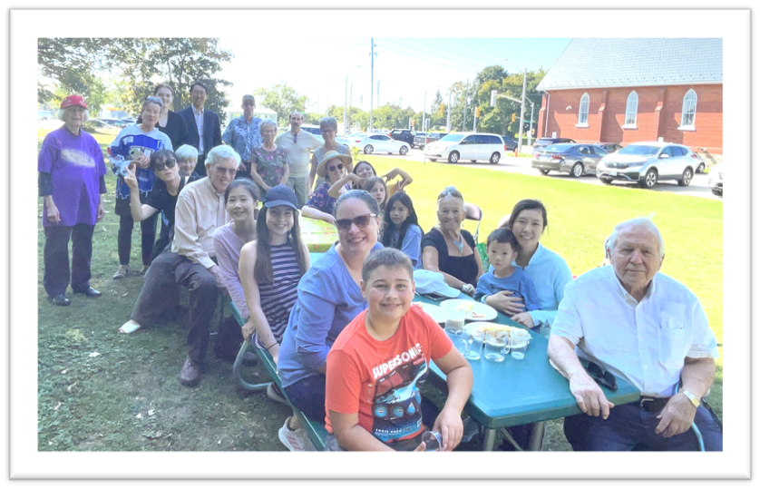
Discipleship Inspired
Data-informed
Whole Church
Hope-Filled
Vision and Strategy for a Bolder Future
Notes:
That was 2025…and now lets look forward to T2035. That is our discipleship inspired, data-informed,, hope-filled, whole church, vision and strategy for a bolder future. This builds on the GCO strategic plan but seeks to be broader and deeper, truly connected, involving all levels of the church

Slide 6

Who Responded
A broad cross‑section of the church:
Over 3,000 respondents
Lay leaders, ministry personnel, staff
Representation from every Regional Council
Pilot, followed by broad release in March
Notes:
We recently conducted a survey on T2035 to help us shape the kind of support communities of faith will need to engage with this vision and participate in this strategy.
What’s useful here is that we can cross tab the results—by role, by regional council –get quite specific as to the particular needs of identities, communities, and regions

Slide 7
10-year Strategic Direction
Approved by General Council Executive in November 2025
In The United Church of Canada, inspired, resilient and diverse contextual communities of disciples seek to continue the story of Jesus by embodying Christ’s presence in the world. The church is present and deeply connected coast to coast to coast in rural and urban settings, and in ecumenical and global relationships. Guided by hope-filled, adaptive and effective ministry leaders, the denomination is increasingly multigenerational, multiracial, and intercultural.
Notes:
This is the 10 year Toward 2025 strategic direction approved by the General Council Executive. The words in red come from our Song of Faith.

Slide 8

Respondents overwhelmingly support the Toward 2035 vision
From the 3053 Survey respondents:
91% support Toward 2035 as a 10‑year direction
Key Insights
Notes:
What the survey said is that across the country, people overwhelmingly support this as a vision—as a strategic direction.
Really great level of support at 91%
Interestingly, your support in Bermuda Nova Scotia was the highest in the country. 98% of those who filled out the survey said they supported this the strategic direction as a 10 year direction for the United Church.

Slide 9
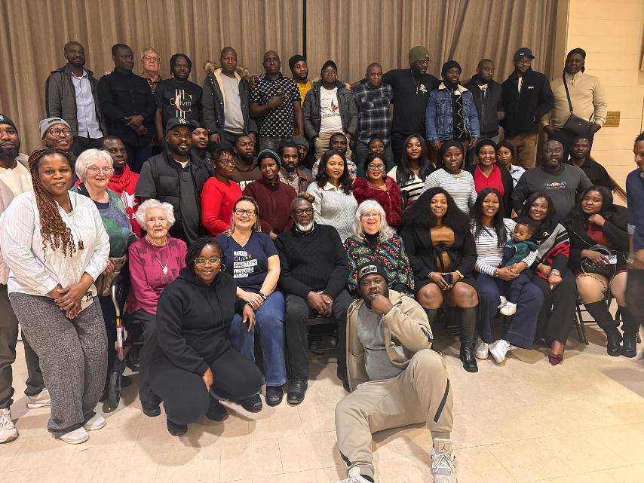
Why Support for the Vision Is So High
People support Toward 2035 because it connects to:
Faith and following Jesus
Inclusion and “All means All”
Hope in the face of decline
Recognition that change is unavoidable
Aspiration, but not naïvete
Notes:
People support Toward 2035 because it connects to:
Faith and following Jesus
Speaks of Inclusion and welcoming all--“All means All”
Offers Hope in the face of decline
Holds a Recognition that change is unavoidable
Appears aspirational, but not naïve

Slide 10

Emotional Responses
“Hopeful… but heavy”
People expressed:
Gratitude that decline is being named honestly
Grief, exhaustion, and fear—especially in rural and aging communities
Relief mixed with realism
This is not resistance. This is mourning and love.
Notes:
In open ended questions people shared their feelings. Even with support for the words of the vision many of the challenges we know were present in people’s responses—grief, exhaustion, fear

Slide 11
When People Are Skeptical
Concerns are not about values – they are about trust
Common themes:
“This feels vague”
“We’ve seen this before”
“There’s no clear plan”
“It feels top‑down”
Skepticism comes from lived experience, not lack of faith.
Notes:
Some people supported the vision but at the same time raised significant concerns with whether or not we could implement this. Their support was “conditional.” They will have to SEE how we are actually moving forward the vision in real steps to address their lack of confidence.

Slide 12
Do you support this as a 10-year direction?
Why Some Answered ‘No’
The “No” responses point to:
Language that feels overly abstract or institutional
Lack of concrete actions or accountability
Rural and small‑church realities being overlooked
Distrust from past restructurings
The high level of support, alongside a small minority of “No” responses (9%), reinforces that hesitations are not broad resistance.
Notes:
If people said no to the vision—small percentage—these were their reasons…

Slide 13
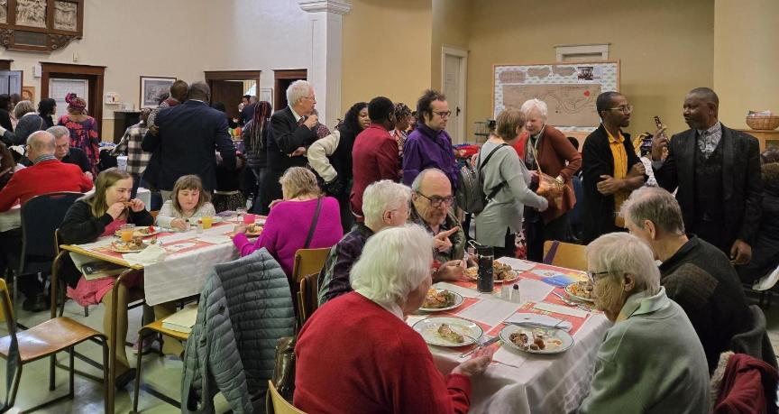
The Message People Heard
What is Toward 2035 saying?
“The whole church must work together for the future” (30%)
“Becoming diverse, contextual communities of disciples requires intentional collaborative effort” (19%)
“God still has work for the United Church to do” (15%)
Notes:
Most common interpretations of Toward 2035 related to:
Connexionalism—this understanding that to make a change we need to work together at all levels of the church all across the country.
And Diversity and Discipleship—both areas we need to strengthen to be a stronger church that reaches more deeply our neighbourhoods.
Different in different neighbourhoods all across the country.

Slide 14
Awareness of Toward 2035 is high especially among denominational leaders
Q3. How familiar are you with Toward 2035?
 | Total familiar | Sample size
ALL | 53% | 3053
GC45 Commissioners | 97% | 69
RC Exec members | 97% | 61
GCO/RCO Staff | 96% | 115
RC Commission/Cmttee | 85% | 101
COF Rep to RC | 79% | 243
Ministry Personnel | 78% | 501
Retired MP | 56% | 201
Lay Staff at COF | 52% | 97
COF Leader | 48% | 1323
COF member/adherent | 41% | 1223
Notes:
Overall—familiarity with Toward 2035 at about 53% but in Bermuda Nova Scotia that was higher—more like 67%
You can see here that in terms of familiarity with T2035, it is largely at the leadership level. So our work moving forward is to close the awareness gap at the congregational level—build more understanding of Toward 2035 and how we can work together at the level of communities of Faith.
Its good to have leaders aware—now we need to take a next step in engagement with congregations.

Slide 15
What Communities Say They Need
To live toward this future, communities need:
Support reaching beyond the church 55%
Help becoming multigenerational 48%
Stronger collaboration with nearby COFs 42%
Discernment resources, Staff Supports, Becoming more Multiracial 36-29%
Real staff support. Not more vision. More accompaniment.
Notes:
You can see the highest areas of need identified is “support in reaching out beyond our church community into our neighbourhoods.”
We will be focusing on these high priority areas identified to provide real support and accompaniment to Communities of Faith.

Slide 16
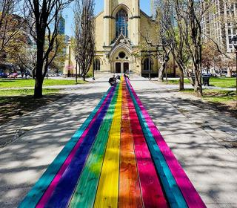
Reaching Out
100 Tables
Growth Animator re invitation

Slide 17
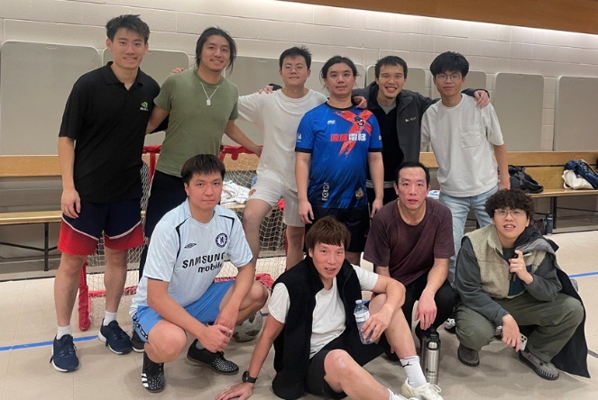
What The Survey Is Really Telling Us
People see the vision but are asking:
Will this be different?
Will we be supported?
Will local realities matter?
Will it change what happens next?
There is not a vision crisis. It is affirmed. Current challenge is implementation.
Notes:
Our work together over the next years is to build awareness at the local level and take credible steps to implement the vision—to address people’s concerns with whether and how we make that vision real in change. Mindful of the lived experience and emotions of grief, fear and exhaustion. We will need to help address a sense of lack of capacity with practical supports. Visible follow through.
Toward 2035 is not a document. It is a relationship.
What we do next will determine whether this becomes another hopeful idea or a lived, shared transformation across the church
The question is no longer “Do we agree?” It is “Will we truly take this journey together?”

Slide 18
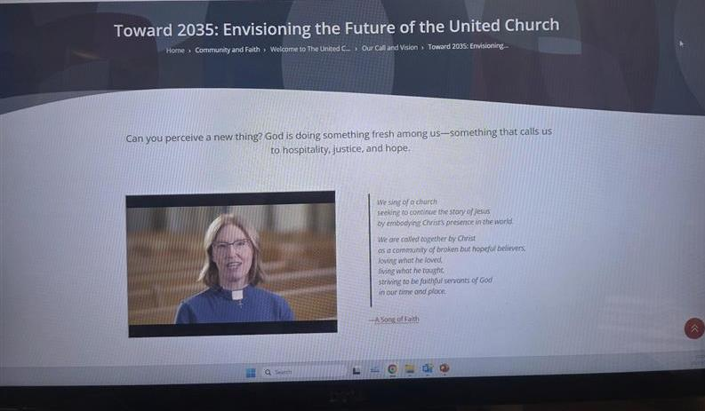
T2035 Resources
Current resources for Toward 2035:
https://united-church.ca/toward2035
Notes:
This is the link to the T2035 on the website including session 1 of congregational resources
Keep your eyes pealed for regional conversations and strategies.
In September look for a national webinar that will offer some more information on next steps
In January we expect to release session 2 of the congregational resource

Slide 19

Zoom Prayers for and with Communities of Faith
Thursdays @ 1:30pm NL | 1pm AT | 12pm ET | 11am CT |10am MT | 9am PT
Email us to share something to be prayed for or to get the registration link.
Growth@united-church.ca
Notes:
Consider contributing items to be prayed for in our weekly national prayer session or participating yourself.

Slide 20

National Indigenous Spiritual Gathering
Carleton University, July 2026
Thank you to the National Indigenous Elders Circle for governing
Election of National Indigenous Council
Living into Remit 1

Slide 21

Review of the 2018 Structural Changes
Report Due in September 2026
Notes:
Two quick other notes.
The Structure Review report—looking at the impact of the changes of 2018--will be out in September, so look for that.
Thanks to folks for contributing to surveys and focus groups.

Slide 22

General Secretary Search
8 person Selection Committee
Job Description approved
Posting the Position
Working with a Firm
Some Flexibility in Timing
Notes:
And given Michael Blair’s intention to retire, a new General Secretary Selection is in process.
An 8 person Selection Committee has been named including the Moderator, some representatives from the General Council Executive and some members at large. They began working in mid May.
General Council Executive approved a Job Description
We will be Posting the Position and also Working with a Firm to support the search.
There will be Some Flexibility in Timing to ensure a good transition.

Slide 23

Remit on Regional Council Membership
Coming Fall 2026

Slide 24
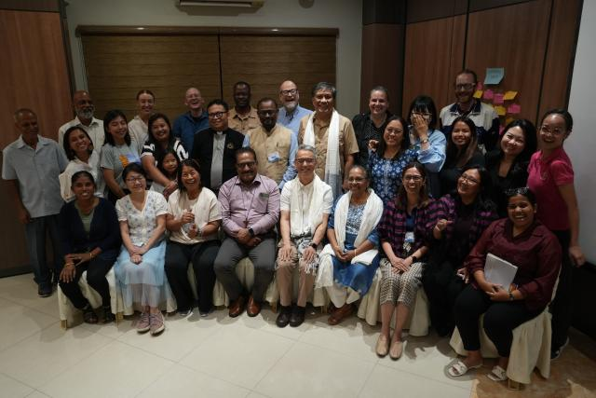
Sustainable Global and Ecumenical Partnerships
Pilgrimages of Learning
Working Group
Ecumenical Relationships—shared presence and cooperative justice initiatives

Slide 25
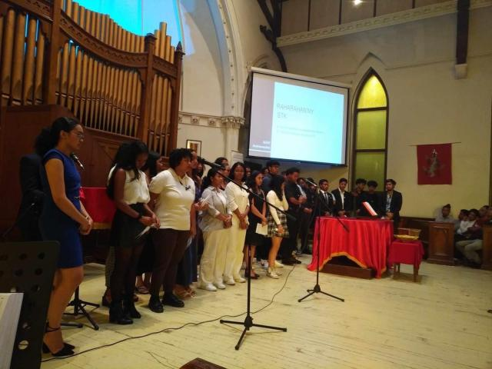
Emerging Communities of Faith
Supporting and Nurturing

Slide 26

THANK YOU
Notes:
For your leadership in your communities
For your leadership in the region
For your support of Mission and Service
And for your continued hope.
Thank you.

